Slide 1


FULL STACK WEB DEVELOPMENT WITH DJANGO
Lecture 17

Slide 2

Today’s Agenda
Developing Our Django App
Static Files In Template Inheritance
Example

Slide 3
Static Files In Template Inheritance
We also can use static files in template inheritance .
However we have to decide , whether we need to use static files at the project level or we need to use them at the app level.

Slide 4
Static Files In Template Inheritance
If we need the same look and feel for all the pages of our site then we must keep static files at the project level and use them in the base.html page.
In this way it will be available to all the pages of our application.
But , if we want a different look and feel for a particular page then we can use these static files at the app level also.

Slide 5
Static Files In Template Inheritance
To start with we will keep the static files at the project level I,e inside the static folder of our mainsite app , which we are using as the default sitewide app.
We will design a new project , just like the previous one but this time with static files support in template inheritance

Slide 6
Steps Needed
Following will be the steps to create the app :
Activating Django Environment in VS Code
Creating a Django Project in VS Code
Creating the apps
Activating the apps
Create the app level templates directory structure.
Creating the static directory structure inside the main app of the project
Creating the base template inside the main app of the project
Using static files in the base template
Creating child templates in specific apps by inheriting the base template
Creating the view to render the template
Configuring the View in app level urls.py
Configuring urls in the project
Running the server
Opening the page in browser

Slide 7
Performing Steps 1 To 5
Now go to the outer project folder demoproject13 and create three apps called mainsite,courses and trainers by using the command:
django-admin startapp mainsite
django-admin startapp courses
django-admin startapp trainers
Now create a folder called templates in each of these apps and within templates create sub folder by the name of the app
Finally update settings.py so that it contains the name of all three apps

Slide 8
Performing Steps 1 To 5
Code:
INSTALLED_APPS = [
'django.contrib.admin',
'django.contrib.auth',
'django.contrib.contenttypes',
'django.contrib.sessions',
'django.contrib.messages',
'django.contrib.staticfiles',
‘mainsite',
‘courses’,
‘trainers’,]

Slide 9
Performing Steps 1 To 5
Make sure that uptill now your project and app folders look as shown on the next slide

Slide 10
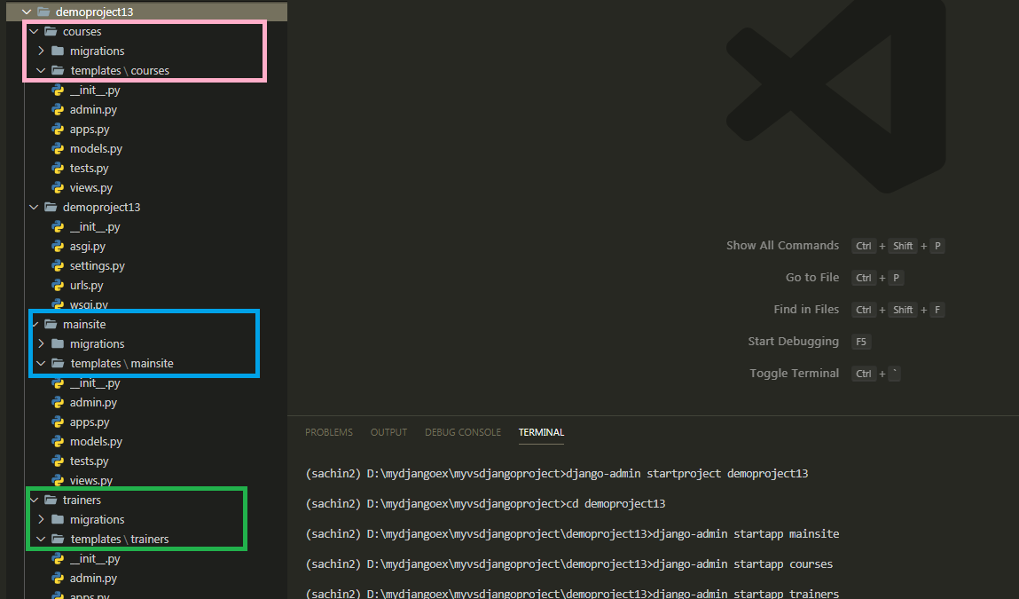
Performing Steps 1 To 5

Slide 11
Step 6: Creating The Static Directory
Create a new folder named static inside the mainsite folder and within static create an inner folder by the name mainsite , and within mainsite create folders for css and images
Copy an image in the images folder .
Create a css file called basestyles.css in the css folder inside the mainsite app and write the code shown in next slide

Slide 12
Step 6: Creating The Static Directory
mainsite/static/mainsite/css/basestyles.css
body {
background-color: burlywood;
}
h2 {
color: brown;
}

Slide 13
Step 7: Creating The Base Template
Create a new file named base.html inside the templates→mainsite folder
Now add the code shown in next slide into it

Slide 14
Step 8: Using Static Files In The Base Template
<!DOCTYPE html>
<html lang="en">
{% load static %}
<head>
<meta charset="UTF-8">
<meta name="viewport" content="width=device-width, initial-scale=1.0">
<title>{% block title%}{% endblock title %}</title>
<link rel="stylesheet" href="{% static 'mainsite/css/basestyles.css' %}">
</head>
<body>
<nav>
<a href="#">Home</a>
<a href="#">Courses</a>
<a href="#">Trainers</a>
<a href="#">About</a>
<a href="#">Contact</a>
</nav>
<img src="{% static 'mainsite/images/scalogo.png' %}" >
<h2> Welcome To Sharma Computer Academy</h2>
<h3>{% block ptitle%}{% endblock ptitle %}</h3>
<ul>{% block listitems%}{% endblock listitems %}</ul>
<h4>{% block footer %}All rights reserved &copy; SCA 2020{% endblock footer %}</h4>
</body>
</html>

Slide 15
Code Explained
This is our base template which is almost same as the previous app with just 3 changes:
We have now loaded static data using the static tag
{% load static %}
In the <link> tag of this base.html file we have loaded the css file basestlyes.css from the mainsite app
We have added a new img tag to show the logo of sca
The benefit will be that all the child templates which will inherit this base template will also get access to this css file as well as image

Slide 16
Step 9:Designing Child Templates
The four child templates which we have designed in the previous app will remain same and used as it is.
Given on the next slide are their codes

Slide 17
backendcourses.html
{% extends ’mainsite/base.html' %}
{% block title %}Back End Courses{% endblock title %}
{% block ptitle %}Our Back-End Courses{% endblock ptitle%}
{% block listitems%}
<li>Django</li>
<li>JEE</li>
<li>Spring Core</li>
<li>Spring Boot</li>
<li>ASP.Net</li>
<li>Node JS</li>
{% endblock listitems %}

Slide 18
frontendcourses.html
{% extends ’mainsite/base.html' %}
{% block title %}Front End Courses{% endblock title %}
{% block ptitle %}Our Front-End Courses{% endblock ptitle%}
{% block listitems%}
<li>HTML 5</li>
<li>CSS 3</li>
<li>Modern Java Script</li>
<li>BootStrap</li>
<li>JQuery</li>
<li>Ajax</li>
{% endblock listitems %}

Slide 19
backendtrainers.html
{% extends ’mainsite/base.html' %}
{% block title %}Back End Trainers{% endblock title %}
{% block ptitle %} Our Back-End Trainers{% endblock ptitle%}
{% block listitems%}
<li>Mr. Naman Garg</li>
<li>Mr. Aftaab</li>
<li>Mr. Arif</li>
<li>Mr. Sachin Kapoor</li>
{% endblock listitems %}

Slide 20
frontendtrainers.html
{% extends ’mainsite/base.html' %}
{% block title %}Front End Trainers{% endblock title %}
{% block ptitle %} Our Front-End Trainers{% endblock ptitle%}
{% block listitems%}
<li>Mr. Paramjeet Singh</li>
<li>Ms. Seema Sharma</li>
<li>Mr. Sanjeev Sharma</li>
<li>Mr. Sachin Kapoor</li>
{% endblock listitems %}

Slide 21
Performing Steps 10 to 12
Finally to make this application functional we need to add code to views.py and both the ursl.py file as before
So we need to perform final 2 steps:
Creating the view to render the template
Configuring the View in Url

Slide 22
Step 10- Creating The View
Open the views.py file in the courses folder and write the following code which calls the template file and returns it to Django
views.py
from django.shortcuts import render
def showFrontEnd(request):
return render(request,'courses/frontendcourses.html')
def showBackEnd(request):
return render(request,'courses/backendcourses.html')

Slide 23
Step 10- Creating The View
Open the views.py file in the trainers folder and write the following code which calls the template file and returns it to Django
views.py
from django.shortcuts import render
def showFrontEnd(request):
return render(request,’trainers/frontendreainers.html')
def showBackEnd(request):
return render(request,‘trainers/backendtrainers.html')

Slide 24
Step 11- Configuring The View In Url
After creating and updating the views.py as shown in the previous slide we perform the next usual step which is configuring the urls
As usual we do this by configuring our URLs at 2 places:
Inside the app directory’s urls.py file
Inside the site’s main urls.py

Slide 25
Step 11- Configuring The View In Url
In the VS Code create a new file called urls.py in both the apps i.e courses and trainers and write the following code in it.
Code (courses/urls.py):
from django.urls import path
from . import views
urlpatterns = [
path('showfe/', views.showFrontEnd),
path('showbe/', views.showBackEnd),
]
Code (trainers/urls.py):
from django.urls import path
from . import views
urlpatterns = [
path('showfe/', views.showFrontEnd),
path('showbe/', views.showBackEnd),
]

Slide 26
Step 12- Configuring The View In Url
In the VS Code open the file called urls.py in the demoproject13 folder and update the code in it as shown below :
Code (demoproject13/urls.py):
from django.contrib import admin
from django.urls import path,include
urlpatterns = [
path('admin/', admin.site.urls),
path('courses/', include('courses.urls')),
path('trainers/',include('trainers.urls')),
]

Slide 27
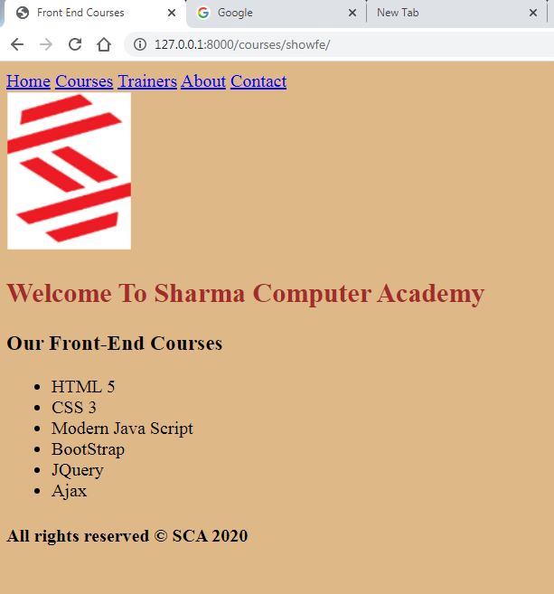
Output

Slide 28

Output

Slide 29

Output

Slide 30

Output

